Slide 1

By - Vivek Patil

Slide 2
Content
Objective of Agile Team
Roles and responsibility of Scrum team members
KPIs/Metrics
KPIs Measurement and Tools
KPIs Reporting to Team and Management

Slide 3
Objective of Agile Team
The Agile team must design the scalable payment platform using the microservices architecture.
Create a CI/CD pipeline to facilitate faster software delivery.
Team needs to collaborate with other teams working on the same project.
Because teams will be interdependent, there should be good coordination between them so that dependencies may be mitigated.
To achieve high quality and minimal to no defect leakage, the application should be thoroughly tested.

Slide 4
Roles and responsibility of Scrum team members
Tech lead - A tech lead is a person responsible for leading a development group. Tech lead guides the technical decision within a team. The responsibility of a tech lead is to drive, lead, motivate the team and its members. He also help the team members to resolve e technical queries/blockers.
Developers - They are cross functional and cross skilled self-organizing team members. They are responsible for developing the code as per the planned sprint to achieve the sprint goals. They are also responsible for estimating the stories and sprint planning. In ideal scrum team developers are consists of Front-end Developers, Backend Developers, Dev-Ops, QA Experts, Business Analyst, DBA etc.
QA engineer - QA engineer analyze the requirement, write and execute the test cases to make sure the product meets its specifications or requirements. They are responsible for finding bugs in the product, which is under test and thereby helping to improve the product quality.
DevOps engineer - Devops engineer is responsible for Designing, building, testing, and maintaining the continuous integration and continuous delivery (CI/CD) process. Automating different phases of the DevOps cycle and monitoring systems for malicious activity
Support engineer - Support engineer is responsible to review and resolve the production issues. He will be first point of contact in scrum team for any production issue without disturbing the whole team. As per his requirement he will reach out to developer in case he need support in resolving the issues.

Slide 5
KPIs/Metrics
Average Team Velocity - Average of last 5 to 6 sprints story points accepted each sprint.
Commitment Reliability - The ratio of points delivered vs points committed in a sprint.
Capacity Utilization - This the ratio of committed story points vs available capacity for the sprint.
Estimation Variance - This is the difference of actual efforts and estimated efforts.
Scope Change - Items added or removed from sprint scope after sprint started.
Defects Leakage - Total number of defects detected after the sprint closure.
Backlog Health – Shows the health of backlog in as number of story Points available in backlog Vs Average Velocity.

Slide 6
KPIs Measurement and Tools
To measure the KPIs we need to define the sprint and project objectives against which we can compare our KPIs values.
For Example:- We define our project requirement under an Epic that will be breakdown into features and features in stories. Epic can be completed in multiple PIs and releases, but every release should have at least one feature.
Average team velocity will help us in predicting how many sprints it will take for a team to deliver a feature. Or how quickly we can plan for releases or how many features the team can deliver per release.
Commitment reliability will give us confidence how well we are planning our sprints and how smoothly the team is approaching to project goal.
Capacity utilization will show how well our team is utilized, if higher the utilization that shows team is working under a pressure and this will decrease the team stability but if team utilization is balanced it will provide more stability in team.
P.T.O…

Slide 7
KPIs Measurement and Tools
Estimation Variance will show how we are estimating stories, if we are spending more or less time than the estimated efforts that shows our estimations are not accurate and we need to think differently while estimating the stories so that our estimation variance should remain less.
Scope change, after the start of the sprint, can lead to missing our sprint goals. If there are frequent scope change within the sprint, then the team needs to align with the product owner and to decide the priority of stories before the sprint start.
Defect leakage matrices will tell how good or bad our product is, and this will also impact our CSAT. Less defect leakage will give more confidence to customer.
A healthy backlog denotes the level of detail in our product backlog that the development teams and mainly product owners need for the project to be successful.
To track the KPIs there are multiple tools available, but I would like to utilize Jira. It gives a wide range of reports that we can utilize to build and manage dashboards. In some cases where Jira doesn't provide specified KPIs mentioned we can leverage excel to maintain the data and calculate the KPIs.​​

Slide 8
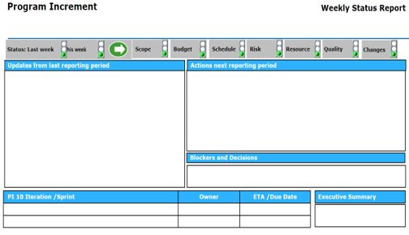
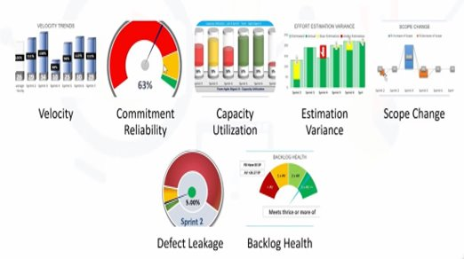
KPIs Reporting to Team and Management
To report the KPIs, I will conduct the weekly status meeting (WSR) where I can report and discuss the KPIs key point that will give confidence to management on how well the team is performing. To report KPIs I will create a dashboard in PPT format with key highlights.
Below is sample report and dashboard.

Slide 9
Thank You

